Slide 1
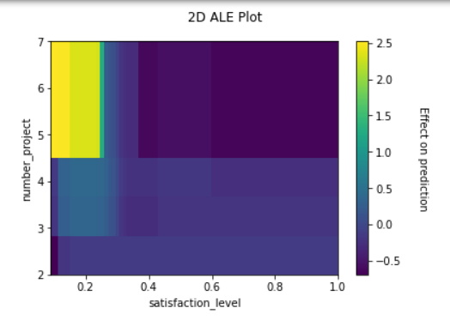
Title: Salifort Motors Employee Churn Analysis
Executive summary prepared for Salifort Motors leadership by Jonathan Fivelsdal
Salifort Motors leadership are interested in learning about how different attributes affect employee churn. Logistic models were created and evaluated on a test set in order to create a useful classification model that could see which factors significantly contribute to whether or not an employee is likely to remain at the company.
Employee churn is a serious concern for Salifort Motors. Some effects of employee churn are the financial costs with hiring and training new employees and the loss of productivity from losing more experienced employees.
Three logistic models were created without interaction terms and three models were created with interaction effects. The model with the best performance has interaction effects and the features satisfaction, tenure,
last evaluation score, number of projects and average monthly hours. To address imbalance in the data between those that left the company and those that didn’t, Synthetic Minority Oversampling Technique (SMOTE) and SMOTE variants were applied to the data and numerical weights were applied to the regression models.
2D ALE plots were made and insights on interaction effects were found. The plot to the right shows the interaction between number of projects and satisfaction level. Employees that had 5 to 7 projects and a satisfaction level of 0.6 or higher (0 to 1 scale) were much less likely to leave on average while those that had 5 to 7 projects but a satisfaction level of less than 0.25 were much more likely to leave on average. Employees with last evaluation scores of 0.7 or lower (0 to 1 scale) and work more than 300 hours on average per month are much more likely to leave and those with evaluation scores greater than 0.7 and work more than 300 hours on average per month are much less likely to leave on average.
Among employees that have 5 to 7 projects and an evaluation score of 0.75 or higher are much less likely to leave while those with an evaluation score of 0.65 or lower are much more likely to leave. Among employees that have a tenure of greater than 5 years, those that work more than 270 hours on average per month are much less likely to leave and those that work less than 100 hours on average per month are much more likely to leave. Among employees with a satisfaction score less than 0.3, those with average monthly hours greater than 150 were much more likely to leave and those that worked less than 150 average monthly hours were much less likely to leave.
The model achieved a 93% AUC on the test data and I would recommend the model to be deployed
Additional explainable AI (XAI) techniques can be applied to gain further insights

